Slide 1


SMART INDIA HACKATHON 2026
TITLE PAGE
• Problem Statement ID – SIH26193
• Problem Statement Title- Student Innovation-Developing solutions, keeping in mind the need to enhance the primary sector of India - Agriculture and to manage and process our agriculture produce.
• Theme- Agriculture, FoodTech & Rural Development
• PS Category- Software
• Team ID- 144426
• Team Name - NextGenCoders

Slide 2
PROPOSED SOLUTION
NextGen Coders
PROBLEM EXISTING
ARCHITECTURE
• Scattered Information: Farmers depend on separate sources for prices, weather, schemes and crop advice.
• Middlemen & Price Gap: Limited direct access to buyers can reduce farmers’ market opportunities.
• Complex & Language Barrier: Agricultural digital tools may be difficult to use for rural and local-language users.
FARMER / BUYER
▼
LOGIN / SIGN UP
Supabase Auth
▼
PROPOSED SOLUTION
FARM INTELLIGENCE
Crop • Weather • Pest • Monitoring • Alerts
• Smart Farm Advisory: Crop monitoring, weather intelligence, pest alerts and early warnings.
• Market & Direct Selling: Mandi prices, price trends, quality grading, seller listings and buyer matching.
• Post-Harvest Support: Harvest prediction, storage recommendations, insurance and scheme discovery.
• Bilingual AI Assistant: English/Telugu interface with an AI chatbot for farmer queries.
▼
HARVEST & QUALITY
Prediction • Grading • Yield Insights
▼
UVP (UNIQUE VALUE PROPOSITION)
MARKET & SELL
Mandi Prices • Marketplace • Buyers
• All-in-One: Grow, monitor, harvest, grade, store, sell and access support from one platform.
• Direct Farmer–Buyer Link: Marketplace connects farmers with buyers through produce listings.
• Local & Accessible: English/Telugu interface designed for practical farmer use.
• Data-Driven: Uses weather, mandi-price and agricultural data to support decisions.
▼
SUPPORT & FINANCE
Schemes • Insurance • Storage • AI
▼
BETTER FARMER DECISIONS & INCOME
React • Supabase • Open-Meteo • data.gov.in • Chart.js
2

Slide 3
TECHNICAL APPROACH
NextGen Coders
Start Here
What does the user need? Grow • Sell • Support
FARM INTELLIGENCE MODE
MARKET & SELL MODE
SUPPORT & FINANCE MODE
Open App & Login
Login as Seller / Buyer
Open App & Login
▼
▼
▼
Select District, Soil, Season
Seller: Crop, Tons, Mobile, Email
Govt Scheme Finder
▼
▼
▼
Fetch Live Weather (Open-Meteo)
Quality Grading of Produce
Crop Insurance Guidance
▼
▼
▼
Crop Recommendation
Listing Saved + PDF Download
Storage & Processing Advice
▼
▼
▼
Harvest Prediction & Monitoring
Buyer Browse & Buyer Matching
Chatbot & Farmer Helplines
▼
▼
▼
Pest Map & Early Warnings
Live Mandi Prices (data.gov.in)
Farmer Gets Best Decision
TECH STACK React (CDN) • Supabase Auth & Database • Open-Meteo Weather API • data.gov.in Mandi API • Bilingual EN/తెలుగు • PDF Export • Chatbot
3

Slide 4
NextGen Coders
FEASIBILITY AND VIABILITY
FEASIBILITY :
VIABILITY :
Technical : Working single-file web app on proven tools (React, Supabase, public APIs); runs in any modern phone browser.
Data : Uses open government mandi data and live weather; no costly hardware or sensors needed.
Innovation : Farm advisory, direct selling, insurance and schemes combined in one bilingual platform.
Operational : Simple onboarding with separate buyer and seller logins; no training needed.
Economic : Free for farmers; low hosting cost on serverless backend.
Market : Large farmer base seeking fair prices and direct market access [add sourced figure].
Policy Fit : Aligns with Digital India, eNAM, PM-KISAN and PMFBY initiatives.
Revenue : Small commission on buyer deals, premium buyer listings, and partnerships with FPOs and agri-input providers.
Scalability : District-level data and language packs can expand to every state.
Retention : Daily-use features (prices, weather, alerts) bring farmers back.
TECHNICAL CHALLENGES :
BUSINESS / USER CHALLENGES :
Risk : Poor connectivity in villages; public API downtime or delayed mandi updates.
Mitigation : Lightweight pages, cached last-known prices and graceful fallbacks when an API is unavailable.
Risk : Low digital literacy and trust; fake buyer or seller listings.
Mitigation : Telugu-first simple UI, chatbot guidance, verified logins and PDF-recorded seller details; partner with FPOs and local agri offices.
4

Slide 5
NextGen Coders
IMPACTS & BENEFITS
Economic Impact : Live prices, quality grading and direct buyer matching help farmers earn a fairer price and reduce dependence on middlemen.
Environmental & Sustainability Gains : Crop recommendation, early pest and disaster warnings and better storage reduce crop loss, input waste and post-harvest wastage.
Social & Governance Transformation : A Telugu-first interface with scheme and insurance guidance improves access to PM-KISAN, PMFBY and state benefits, supporting Digital India.
Feature | Existing Solutions | KrishiDost
Live Mandi Prices | ! | ✓
Crop Recommendation & Harvest Prediction | ! | ✓
Pest Map & Early Warnings | ! | ✓
Direct Buyer–Seller Matching | ✗ | ✓
Quality Grading of Produce | ✗ | ✓
Storage & Processing Advice | ✗ | ✓
Govt Schemes & Insurance Guidance | ! | ✓
Regional Language (Telugu) Support | ! | ✓
AI Chatbot & Helplines | ! | ✓
All-in-One Platform | ✗ | ✓
✗ Not available ! Partial / fragmented ✓ Available
HOW KRISHIDOST WORKS
MODE 1: FARM INTELLIGENCE (Grow)
MODE 2: MARKET & SELL (Sell)
MODE 3: SUPPORT & FINANCE (Protect)
For : Farmers planning, growing and monitoring crops
Process : Login → Select district & crop → Get recommendation, forecast and alerts
Best For : Crop choice, pest control, weather risk
For : Sellers (farmers) and buyers
Process : Login → List crop or browse → Match → PDF record of listing
Best For : Fair prices, direct deals, mandi tracking
For : Farmers needing schemes, cover and storage
Process : Login → Check schemes / insurance → Storage advice → Chatbot help
Best For : Subsidies, risk cover, post-harvest care
@KrishiDost
5

Slide 6

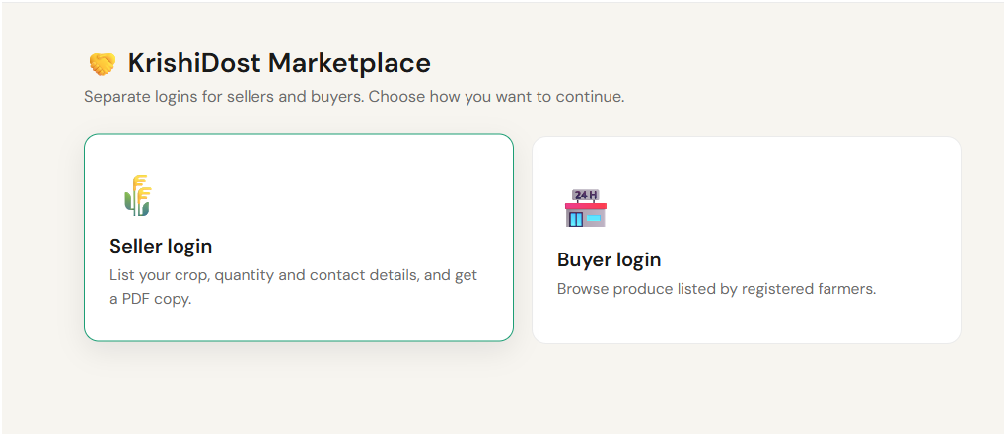
NextGen Coders
RESEARCH AND REFERENCES
Government data : Live mandi arrival and price records come from the Open Government Data platform (data.gov.in).
Weather : Location-based forecasts are fetched from the Open-Meteo API.
Schemes & policy : PM-KISAN, PMFBY (crop insurance), KCC, eNAM, Rythu Bandhu and other state schemes are covered in the Govt Schemes module.
Market reports : [Add sourced links on agri market size and post-harvest loss, e.g. NITI Aayog / Ministry of Agriculture]
SOLUTIONS ALREADY EXIST
OUR SOLUTION STANDS OUT
Most tools cover only one need: prices, advice or schemes.
Not bilingual or simple enough for many rural users.
Available apps : eNAM / Kisan Suvidha / mKisan / Kisan Call Centre
All-in-one : grow, sell, store, insure
Direct : farmer-to-buyer matching
Local : Telugu and district-level data
Trusted : uses official government data
PROJECT RESOURCES
Prototype : [Add live app link]
GitHub : [Add link]
@KrishiDost
6

Slide 7
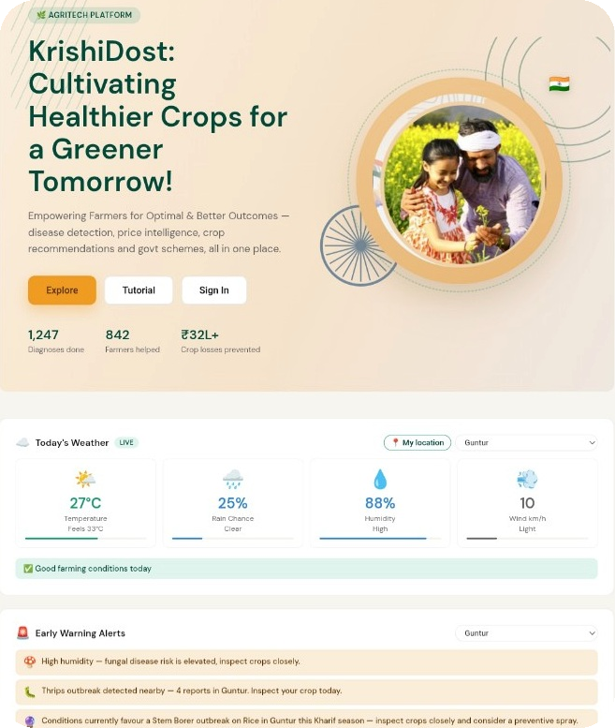
NextGen Coders
TECHNICAL APPROACH
TECHNICAL APPROACH
CROP IMAGE
FARMER / WEB UI
CROP + FARM DECISION
PROTOTYPE EVIDENCE
↓
UPLOAD
Leaf / stem / fruit
React
Interface
INPUTS
District • soil • season
↓
PREPROCESS
OpenCV + NumPy
Node.js
API layer
MODEL
Random Forest
↓
AI INFERENCE
Python + YOLOv8
Supabase
Auth + PostgreSQL
OUTPUT
Suitable crops
↓
RESULT
Disease + severity
Leaflet
Maps / heatmap
COMPARE
Profit / market view
↓
GUIDANCE
Actionable advice
Image path: Capture → Base64 → Python AI → Result → Farmer guidance
AI • ML • market • pest modules

